Slide 1

🌿 Transform Your Outdoor
Step into a world where nature meets design. This booklet is your guide to creating inviting, stylish, and functional outdoor spaces. From lush plant options that bring life and color, to carefully chosen pots that frame them beautifully, every detail matters.
Discover the textures of stones that ground your garden with character, the glow of outdoor lights that set the mood, and the comfort of furniture that turns patios into living rooms under the sky.
Whether you’re crafting a tranquil retreat or a vibrant entertaining area, these curated selections will help you shape an outdoor space that reflects your personality and lifestyle.

Slide 2

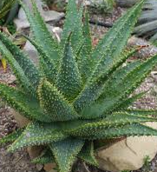
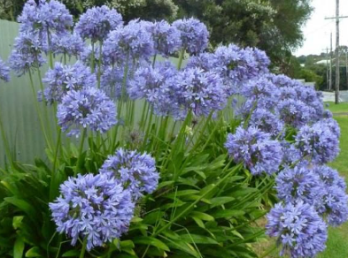
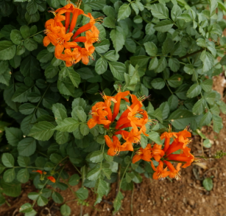
LOW MAINTENANCE GARDEN

Slide 3
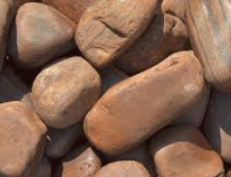
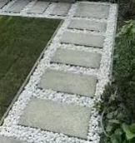
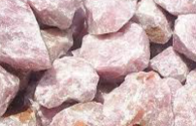

ROCKS AND STONES
White Rock
White Rock Crush
Brown River Rock
Brown Gravel Pebble
Rose Quartz rock
Quartz Pebble

Slide 4
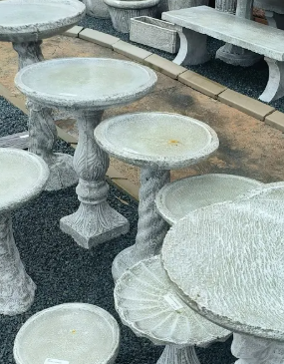
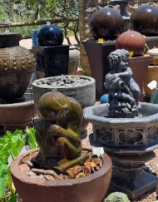
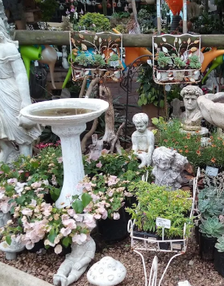
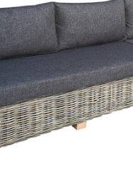
OUTDOOR FURNITURE

Slide 5
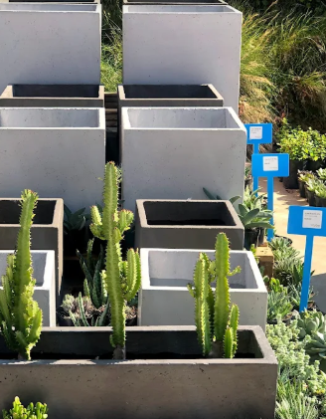
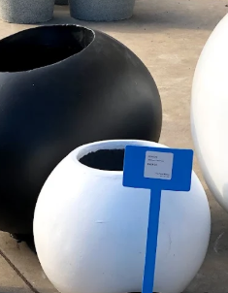
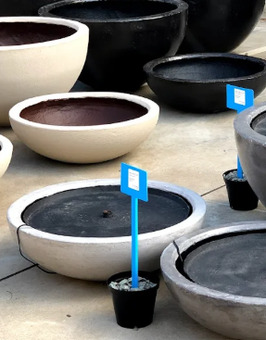

POTS

Slide 6
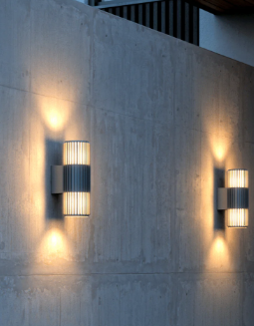
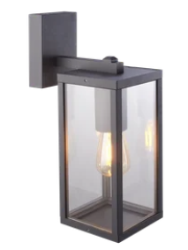
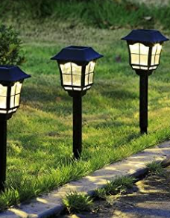
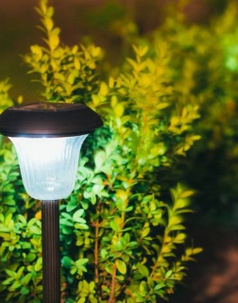
OUTDOOR LIGHTS

